Slide 1
AMAZON PRODUCT DATA ANALYSIS AND HUNTING PRODUCT 1:Plant Pot Saucer

Slide 2
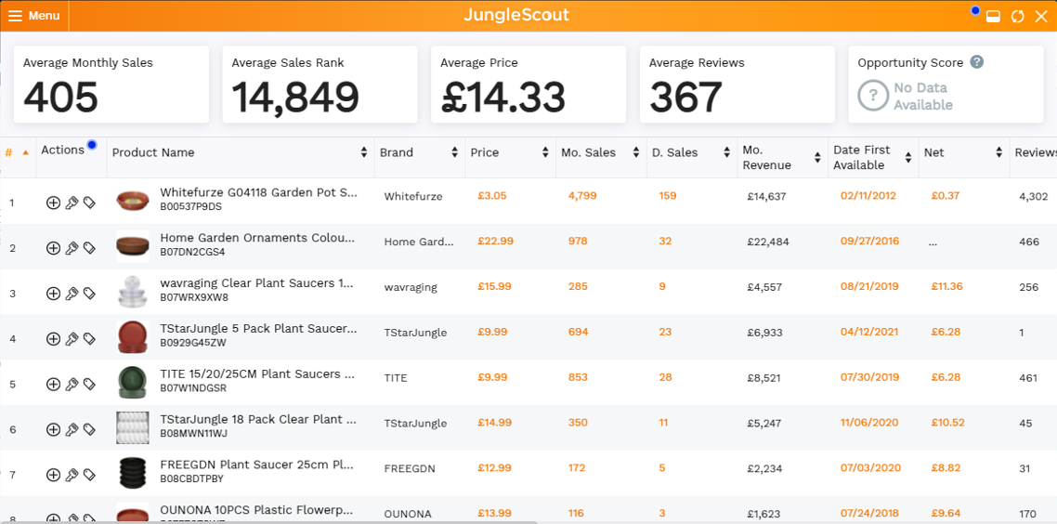
JUNGLE SCOUT DATA RELATED TO PLANT PLOT SAUCER

Slide 3
JUNGLE SCOUT DATA INSIGHTS
The plant pot saucer market is ripe for strategic entry. With an average monthly sales volume of 405 units and an average price of €14.33, the category shows clear paths to profitability—whether targeting bulk buyers with budget packs or premium customers with decorative variants. Jungle Scout data confirms consistent demand and optimized listings across multiple brands, with no single player holding a monopoly—making it a balanced, opportunity-rich space for new entrants.

Slide 4
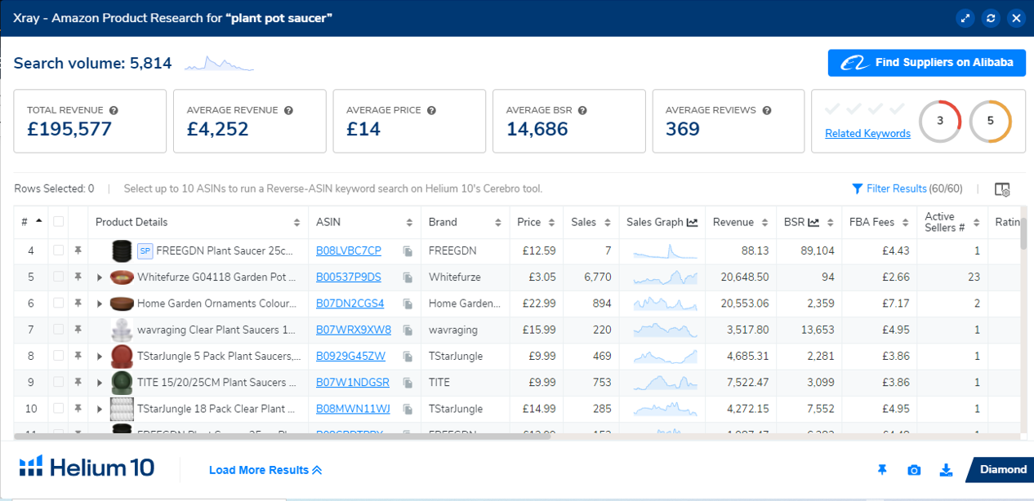
HELIUM 10 DATA RELATED TO PLANT PLOT SAUCER

Slide 5
HELIUM 10 DATA INSIGHTS
The plant pot saucer market is balanced and scalable. With an average price of £14 and average revenue around £ 4252 , sellers can profit through either volume-based low pricing or bundled premium packs. Helium 10 confirms what Jungle Scout hinted: no monopoly, consistent demand, and multiple viable entry points—making this niche ideal for strategic expansion or brand testing

Slide 6
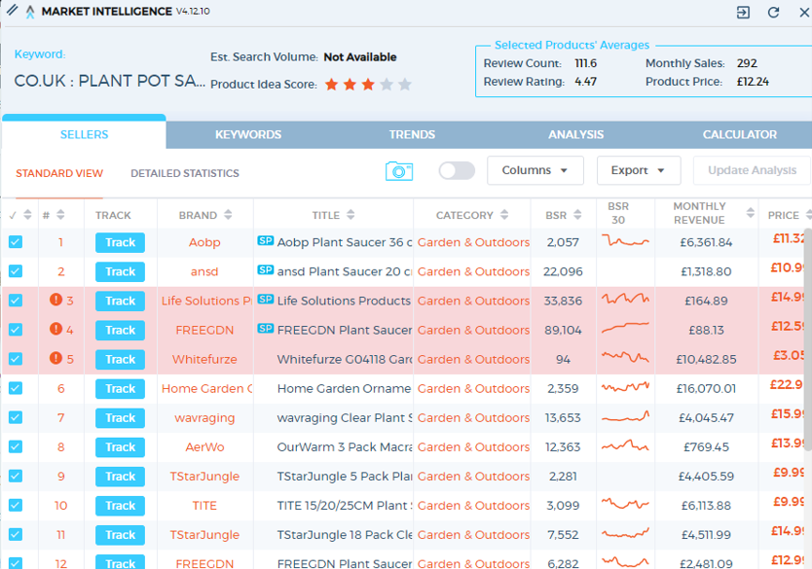
MARKET INTELLIGENCE DATA RELATED TO PLANT PLOT SAUCER

Slide 7
MARKET INTELLIGENCE DATA INSIGHTS
The plant pot saucer market is balanced, scalable, and non-monopolized. With average monthly sales of 405 units, average price between £11.35–£14.33, and consistent revenue across brands, this niche offers multiple entry points—whether through budget packs, decorative variants, or SEO-optimized listings. Market Intelligence reinforces what Helium 10 and Jungle Scout revealed: a stable, opportunity-rich space for data-driven sellers.

Slide 8
DECISION MAKING
This product is good to invest in due to its consistent demand, balanced competition, and proven revenue potential across multiple platforms. With strategic branding, optimized listings, and smart sourcing negotiations, sellers can overcome saturation and pricing pressure while capturing market share. The absence of monopoly and stable sales trends make it ideal for scalable entry and long-term growth.

